Slide 1
Freshman Information Night
January 12, 2026

Slide 2
Who We Are
MS. BRITTANY MANUEL
A-F
MS. JESSICA WALSH
G-O
MS. MARY LOU INGRAM
P-Z
SEEK US OUT AND WE WILL HELP YOU!

Slide 3

High School Timeline

Slide 4
9th Grade
Freshman Orientation
End of 1st Marking Period meeting with Counselor
Course Selections/Introduction to SCOIR
Spring meeting with Counselor (review course selections, create four year plan)
Get involved in clubs & activities

Slide 5
10th Grade
Continue to explore interests/be involved (through classes, electives, clubs, sports, work, volunteering) BALANCE!
Accelerated 10th graders can take the PSAT for the first time
All 10th graders should plan to take the PreACT
Students who are interested in BOCES should visit campus (we will discuss this with students during course selections)
Individual meeting with Counselor to discuss course selections in the Spring

Slide 6
11th Grade
Focus on studies-colleges focus on Junior year grades
Take the PSAT/NMSQT in October
Meet with college representatives visiting the Counseling Center
Attend Financial Aid Night in the Fall
Attend College Information Night in February
Counselors will meet with families to discuss post-secondary plans
Register for the SAT and/or ACT on scheduled test dates
During breaks, schedule official college visits
BALANCE!

Slide 7
12th Grade
Continue to meet with college representatives visiting in the fall
Each senior will meet with their counselor in the beginning of the year to discuss future plans
For students applying to colleges, counselors will work with them to clarify application questions/timelines
Most students applying to colleges should plan to complete their applications by December break
May 1st is the deadline for students to submit deposits to the college of their choice

Slide 8

Diploma Types
Regents Diploma
Advanced Regents Diploma

Slide 9

Graduation Requirements
REQUIRED COURSES
Regents Diploma | Advanced Designation Diploma
Required Credits |  | Required Credits
English | 4 | English | 4
Social Studies | 4 | Social Studies | 4
Math | 3 | Math | 3
Science | 3 | Science | 3
LOTE | 1* | LOTE | 3*
Art & Music | 1 | Art & Music | 1
Physical Education | 2 | Physical Education | 2
Health | .5 | Health | .5
Electives | 3.5 | Electives | 1.5
Total | 22 | Total | 22
All students must have 22 credits to graduate
*Students who complete a CTE sequence can graduate with the Advanced Diploma with one credit of LOTE

Slide 10
Regents Exams Requirements Marked with ® on 4 year plan
Regents Diploma | Advanced Designation Diploma
English Language Arts (ELA) | English Language Arts (ELA)
Global History and Geography | Global History and Geography
United States History and Government | United States History and Government
Science | 2 Science Regents Exams (One in Life Science area, One in Physical Science area)
Math | 3 Math Regents Exams (Algebra 1, Geometry, Algebra 2)
Total: 5 | + Foreign language Checkpoint B (end of 3rd year of language) Total: 9
*Pathway Diploma Options

Slide 11
4 Year Plan
Grade | 8 | 9 | 10 | 11 | 12
English |  | English 9 | English 10 English 10 H | English 11® AP Comp & Lang® | College Comp & Lit AP Comp & Lit English 12 Creative Writing Public Speaking
Social Studies |  | Global 9 | Global 10® AP World History® | US History® AP US History® | Econ./Part. In Gov. AP European History SUNY Economics SUNY Public Aff.
Math | H Algebra ® | Regents Algebra® H Geometry® | Regents Geometry® H Algebra II® | Algebra II ® College Pre-Calculus AP Statistics | College Pre-Calculus College Calculus/AP Calculus Algebra II® AP Statistics Statistical Methods & Modeling
Science | Earth Science® | Earth Science® Biology®/Honors® | Biology® Chemistry®/Honors® | Chemistry®/Honors® AP Enviro. Science AP Biology Ecology AP Physics 1 Integrated Physical Science Energy in Science | Physics Integrated Physical Science AP Physics 1 / AP Physics 2 AP Biology AP Enviro. Science Ecology Energy in Science
Foreign Language | French Spanish Latin | French Spanish Latin | French Spanish Latin | French Spanish Latin | French AP Spanish AP Latin
Art/Music |  | Studio Art Chorus Band Orchestra DDP | Band Orchestra Chorus Art Tech | Band Orchestra Chorus Art Tech | Band Orchestra Chorus Art Tech
Health
Electives |  |  |  | BOCES | BOCES New Visions

Slide 12

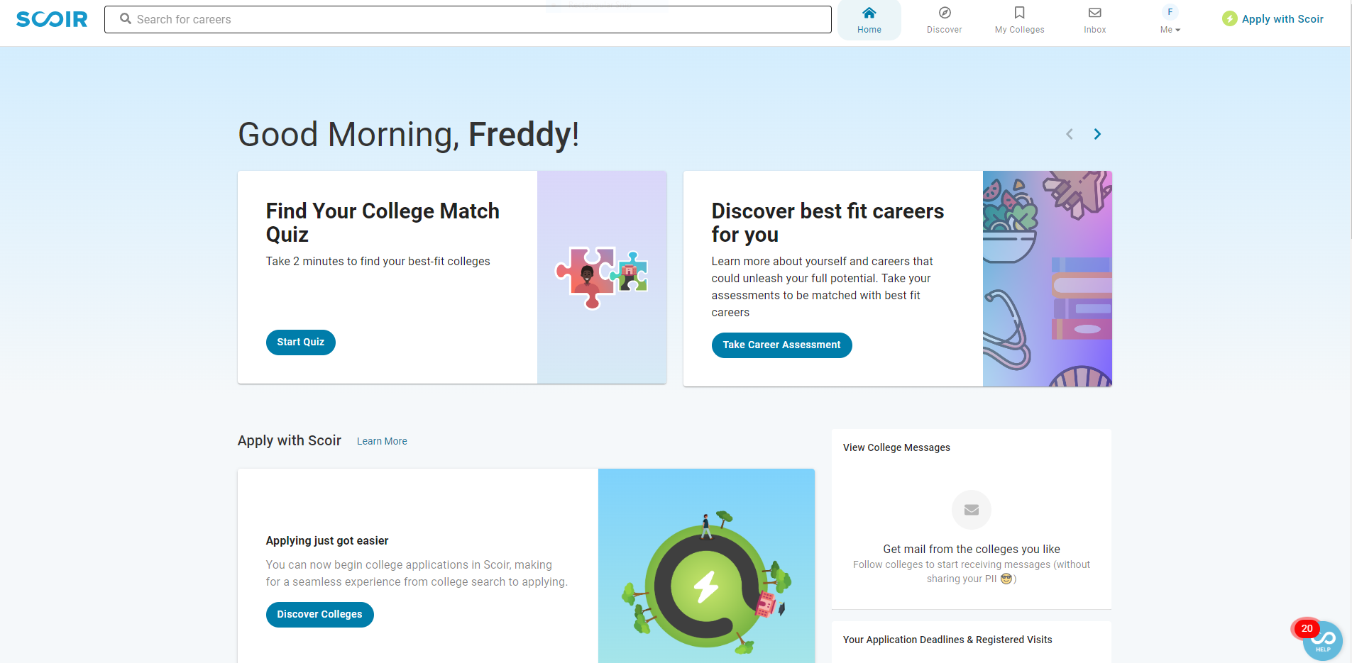
SCOIR
Our new college and career exploration tool
Students complete interest inventories throughout high school (9th graders completed the Career Interest Assessment in SCOIR this year)
All students log in using their skanschools google account.

Slide 13
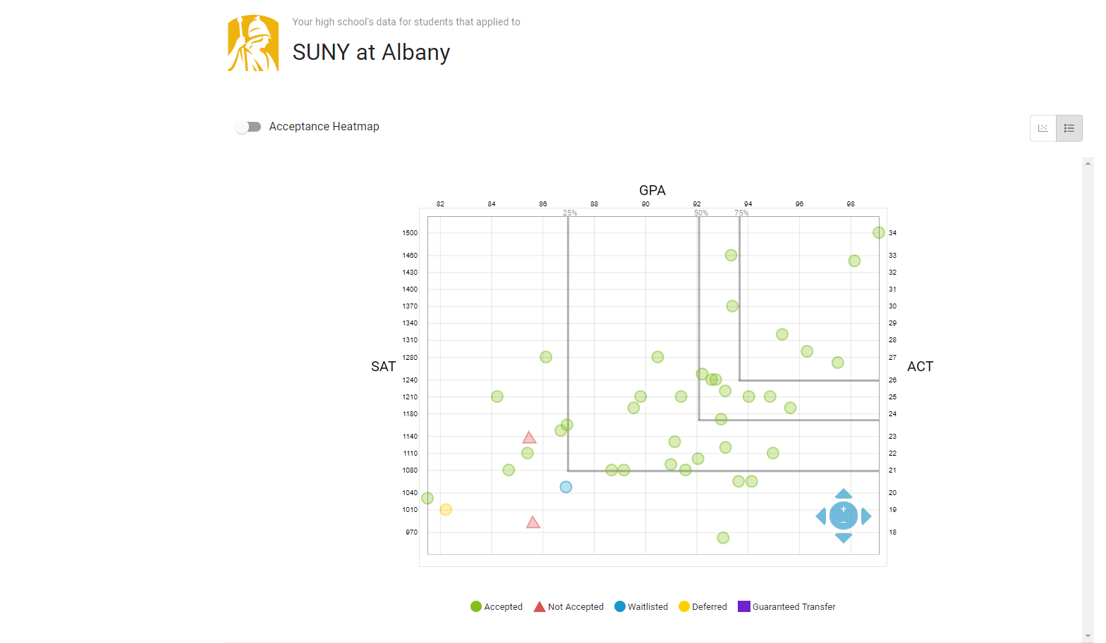
College Exploration with Scoir
-Research colleges
-Look at historical application data
-Search filters

Slide 14
SchoolTool
An easy way to keep track of grades, assignments, attendance, scheduling, etc.
Course Selections
Link available on the school website!

Slide 15
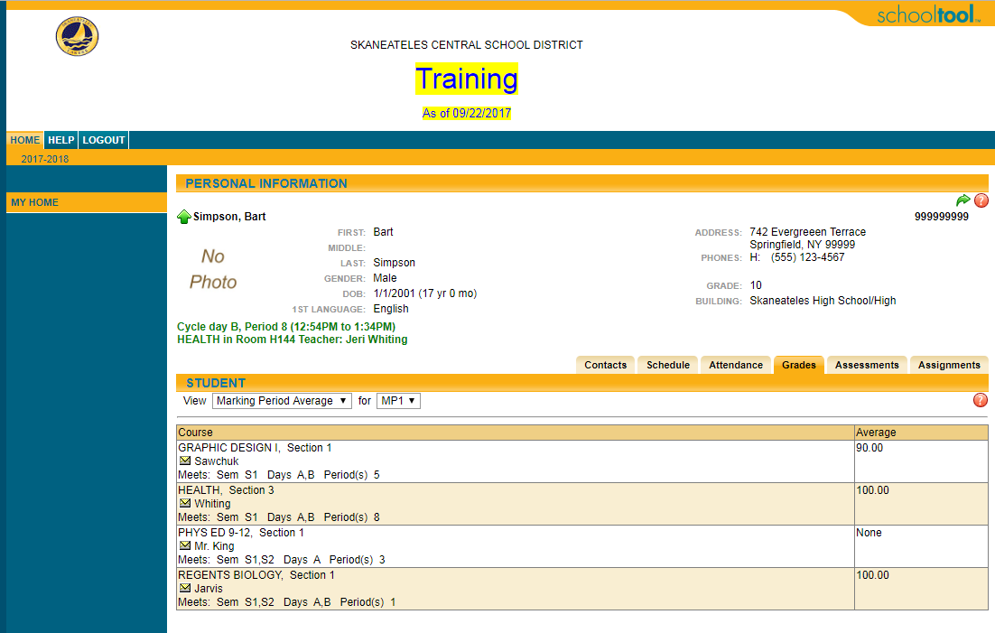
SchoolTool
Schedule, attendance, assignment/grade information

Slide 16
High School Counseling Center Website
Breaking News/opportunities
Timelines for each grade level
Scholarship information
Resources for study skills and test preparation
Relevant articles
Program of Studies Guide

Slide 17

THANK YOU!

