Slide 1

Financial Aid 101
2026-2027 Academic Year

Slide 2
Discussion Topics
What is Financial Aid?
Student Aid Index
Cost of Attendance (COA)
Financial Need
Sources and Types of Financial Aid
Changes for 2026 - 267
Forms to File – FAFSA, CSS, TAP, EXCELSIOR
Award notifications
Special Circumstances

Slide 3
What is Financial Aid?
Financial aid consists of funds provided to students and families to help pay for postsecondary educational expenses
Includes grants, scholarships, loans, work-study, etc.

Slide 4
General Eligibility Requirements (for federal financial aid)
Be a U.S. citizen or eligible noncitizen
Attend a college approved for federal funding
Enrolled in an eligible degree or certificate program
Maintain satisfactory academic progress
Provide consent and approval to have your federal tax information transferred directly into your Free Application for Federal Student Aid (FAFSA®) form
Sign the certification statement on the FAFSA form stating that you’re not in default on a federal student loan, you do not owe money on a federal student grant, and you’ll only use federal student aid for educational purposes

Slide 5
What is the Student Aid Index (SAI)?
The SAI formula calculates the total financial resources of you and your parents then deducts the minimum amount needed for your family's normal annual living expenses.
Student contribution
Parent contribution
(for dependent students)
Notes:
Not what the family will owe, but it is used in determining aid eligibility – range from -1,500 to 999,999 – 2 components – parent and student

Slide 6




What is Cost of Attendance (COA)?
Tuition and fees
Housing and food
Books and supplies
Transportation
Miscellaneous personal expenses

Slide 7
What is the Financial Need?
Cost of Attendance (COA)
– Student Aid Index (SAI)
= Financial Need

Slide 8
Financial Need: An Example
Tuition 53,416
Housing/Meals/Insurance 16,192
Books 850
Personal Expenses/Transportation 1,030
Direct Loan Fee 70
Cost of Attendance 71,558
– Student Aid Index (SAI) 20,000
= Financial Need 51,558

Slide 9
Sources of Financial Aid
Federal Government
Employers
States
Private Sources
College and Universities

Slide 10
Federal Government
Largest source of financial aid
Aid provided primarily on financial need
Must apply each year using the FAFSA
Eligibility requirements must be met

Slide 11
Federal Student Aid Programs
Federal Pell Grant*
Federal Supplemental Educational Opportunity Grant (FSEOG)
Teacher Education Assistance for College and Higher Education (TEACH) Grant
Federal Work-Study (FWS)
Federal Direct Student Loans (Direct Loans)
Federal Direct PLUS Loans*
*Changes to program effective with 2026-27 award year

Slide 12

Federal Pell Grant Changes
Creation of Workforce Pell Grant
Limitations on Pell Grant eligibility
Student is not eligible for the Pell Grant if:
SAI exceeds twice the maximum Pell Grant amount ($14,790); or
Student’s nonfederal grants and scholarships cover entire COA (even if otherwise eligible)
Notes:
Provided for short-term training programs (8 to 15 weeks) that meet certain requirements. Not all schools offer this program. Maximum amount of Pell $7,395. $14,790 is $7,395 x 2. SAI cannot exceed $14,790 to be eligible for Pell

Slide 13
Parent PLUS Changes
New borrowers on or after July 1, 2026:
Annual loan limit: $20,000 per dependent student
Aggregate loan limit: $65,000 per dependent student
Legacy borrowers may borrow at previous loan limits for the shorter of:
3 academic years; or
Time for student to complete program

Slide 14
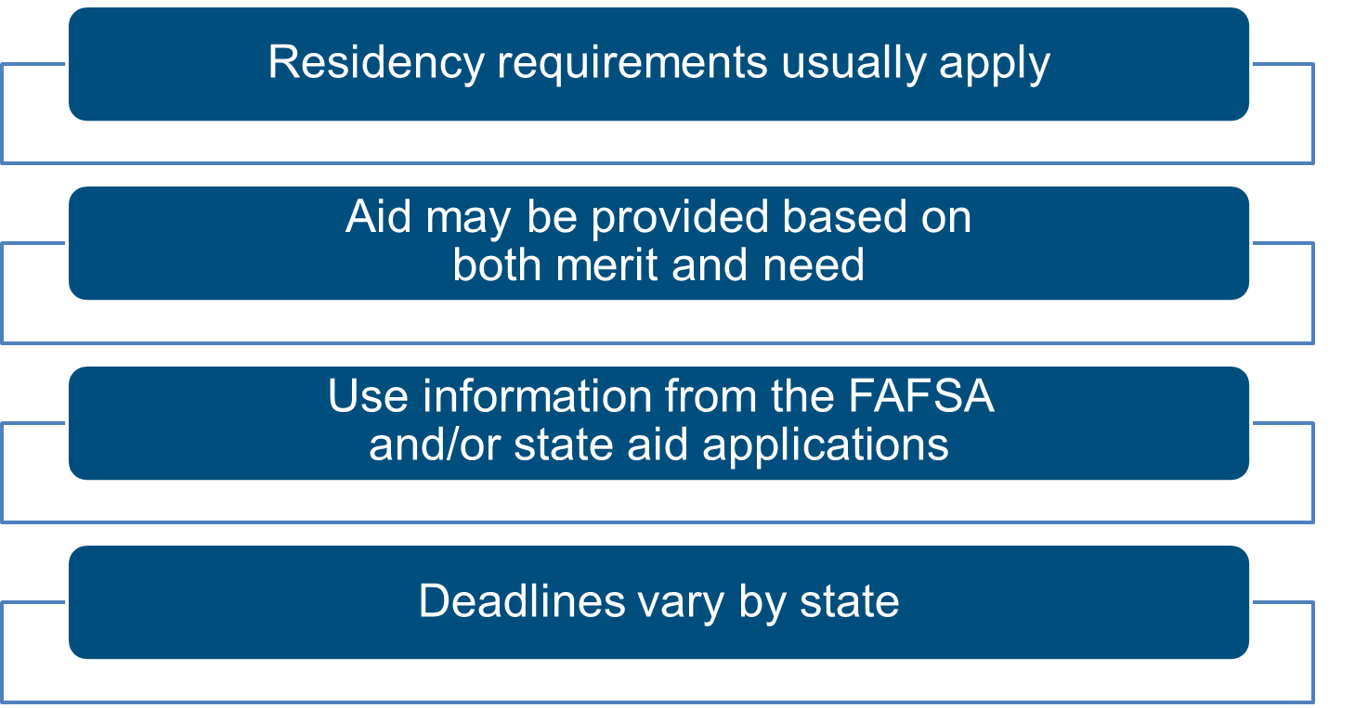
States

Slide 15
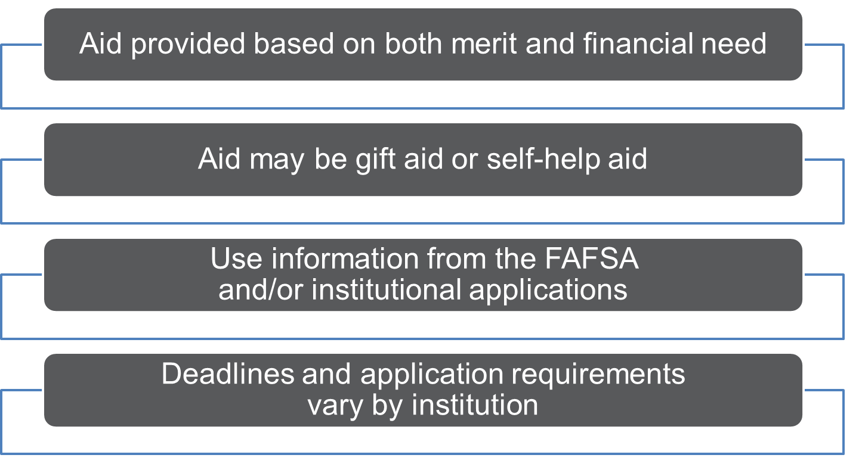
Colleges and Universities

Slide 16
Private Sources
Foundations, businesses, churches, civic, and charitable organizations
Deadlines and applications procedures vary
Begin researching private sources early

Slide 17
Employers
May have scholarships available to the
children of employees
May have educational benefits for their employees

Slide 18
Categories of Financial Aid
Need-based aid
Non-need-based aid

Slide 19
Types of Financial Aid
Scholarships
Grants
Work-Study Employment
Loans
Self-Help Aid
Gift Aid

Slide 20
Gift Aid: Scholarships
Scholarships are typically not based on financial need
Academic and/or Talent components
Require full-time enrollment and cumulative grade point average (GPA) for renewal
Do not need to be repaid

Slide 21
Gift Aid: Grants
Grants – federal, state, and institutional aid provided on the basis of financial need and typically do not have to be repaid
Institutional Grants
Usually limited at public institutions
Private institutions will have more resources; not all private colleges have the same funding levels to spend
Ask each college what type of aid they offer and whether it is based on financial need
Check each college financial aid websites or contact their financial aid offices
Awards may change from year to year if financial need changes (based on annual FAFSA and CSS Profile, if required)

Slide 22
Self-Help Aid: Employment
Student Employment Opportunities
Federal Work Study based on financial need
Students normally work 10-12 hours a week and are paid directly for any hours worked

Slide 23
Self-Help Aid: Loan Types
Federal Direct Subsidized and Unsubsidized Loans
Subsidized is need-based and interest does not accrue while the student attends at least half time. Current interest rate is 6.39%
Unsubsidized is not based on need and interest accrues from the time of disbursement. Current interest rate is 6.39%
Federal Direct PLUS Loan (PLUS = Parent Loan for Undergraduate Students)
Federal loan program available to parents of dependent undergraduate students. Current interest rate is fixed at 8.94%

Slide 24
Self-Help Aid: Loan Types (continued)
Private, Alternative Loans
Loan programs that allow students/families to meet their educational costs
Usually require a cosigner for student borrowers and the student must be 18
Interest rates can be variable or fixed
ELMSelect – some schools partner with ELMSelect to make comparing private student loans easy.

Slide 25
Outside Resources
Explore Community Foundations and local organizations such as Rotary Club, Kiwanis, 4-H
Check with your employer
Scholarship websites:
www.fastweb.com
www.finaid.org/scholarships
www.careeronestop.org/GetMyFuture/Toolkit/find-scholarships.aspx
https://bigfuture.collegeboard.org/pay-for-college
Never pay to apply for scholarships

Slide 26
Free Application for Federal Student Aid (FAFSA®)

Slide 27
Free Application for Federal Student Aid (FAFSA®)
For the 2026-27 academic year, the FAFSA will be available by October 1st
https://studentaid.gov/
Colleges may set FAFSA priority dates
Collects demographic and financial information
Information is used to calculated the student aid index (SAI)
Notes:
36 questions

Slide 28
What do I need to get started?
Get an FSA ID and password (create account)
https://studentaid.gov/fsa-id/create-account/launch
Student and parent must create own FSA ID
Create FSA IDs as soon as possible – can typically get an FSA ID and complete a FAFSA form on the same day, but may have limited functionality
Decide which colleges should receive information
Bank statements and investment records
Social Security Card
ensure social security number and name match what is on the card

Slide 29
FUTURE Act Direct Data Exchange (FA-DDX)
Allows for an individual’s federal tax information (FTI) to be directly transferred from the IRS to the FAFSA
Consent is required by all contributors on FAFSA
IRS transfers information to populate FAFSA income questions for most tax filers
Eliminates manual entry of tax and income information

Slide 30
Common FAFSA Mistakes
Not creating a studentaid.gov account before starting your FAFSA.
Not knowing state and school deadlines.
Not providing consent to have tax data transferred.
Not inviting the required contributor (parent).
Inputting SSN incorrectly.
Forgetting to sign.

Slide 31

CSS PROFILE
Used by most private colleges to award institutional funds
https://cssprofile.collegeboard.org/
Available on October 1st each year
$25 initial application fee (one time charge)
$16 charge for each additional report
Approximately 200 questions
Must be filed electronically

Slide 32

NYS TAP
https://www.tap.hesc.ny.gov/totw/
Application opened on July 1, 2025
Based on family’s NYS taxable income – up to $125k
Awards currently range from $1000 - $5665
Must attend an eligible NYS institution
Awards are for 8 semesters of full-time attendance

Slide 33

NYS Excelsior Scholarship
www.hesc.ny.gov/excelsior
Must be NYS resident at least 12 months prior to first day of enrollment
Federal AGI cannot exceed $125,000
Must attend SUNY or CUNY (State or City college in NY)
Student must be enrolled in at least 12 credits each semester of award; must earn 30 credits per year
Must agree to live and work in New York State for a duration equal to the number of years you received the scholarship
Maximum award is $5,500
if eligible, the recipient will receive a tuition credit

Slide 34
What happens after I apply?
A FAFSA submission summary is sent to the student and colleges listed.
Verify that the information is correct
If corrections are needed, return to studentaid.gov and make corrections as soon as possible
Review the Student Aid Index
Schools will use this number to determine aid eligibility
Colleges will send communication outlining a financial aid package
Read financial aid information carefully
Some colleges require students to accept or reject some or all aid offered

Slide 35
What happens after I apply?
After submission, you'll receive a confirmation email with your estimated Student Aid Index (SAI).
Review your Student Aid Index (SAI)
The Department of Education processes your form and sends it to your chosen colleges within 1-3 days.
Colleges will send communication outlining a financial aid package
Read financial aid information carefully
Some colleges require students to accept or reject some or all aid offered

Slide 36
Award Notification
Financial aid packages are released once all forms have been submitted and the student has been accepted for admission
Single release date – colleges may hold all packages and release on one set date
Rolling release – colleges release on a daily basis as packages are completed

Slide 37
Special Circumstances
Conditions exist that cannot be documented with the FAFSA
Send written explanation and documentation to your college’s financial aid office
College will review and request additional information if necessary
Decisions are final and cannot be appealed to U.S. Department of Education

Slide 38
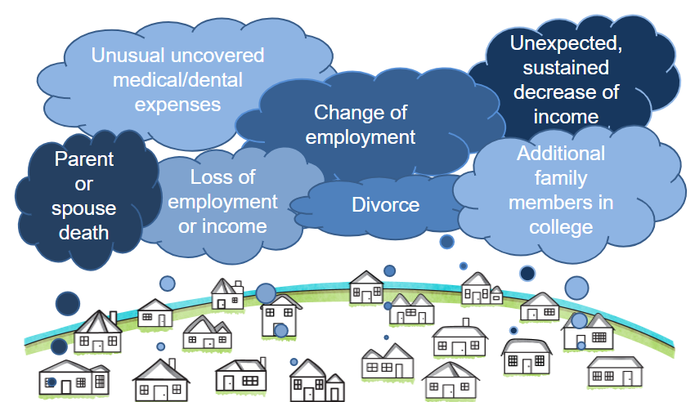
Special Circumstances

Slide 39
Questions?

Slide 40
Contact Information
Shana Gore
Associate Vice President
Enrollment and Student Financial Services
Ithaca College
sgore@Ithaca.edu
607.274.3131 (phone)
607.274.1895 (fax)
www.ithaca.edu/finaid
sfs@ithaca.edu

