Slide 1
Freshman Information Night
Monday, January 23, 2017 @ 7 pm

Slide 2
Who We Are
Mrs. Barbara Drozynski
A-F for all grade levels
Ms. Jessica Walsh
G-O for all grade levels
Mrs. Mary Lou Ingram
P-Z for all grade levels
Seek us out and we will help you!

Slide 3

Diploma Types
Regents Diploma
Advanced Regents Diploma

Slide 4

Graduation Requirements
REQUIRED COURSE SUBJECTS
Subject | Credits | Regents Exams
English | 4 | 1 (English Language Arts)
Social Studies | 4 | 2 (Global History and Geography & U.S. History and Government)
Math | 3 | 1 (Algebra 1)
Science | 3 (1 Unit in Life Science, 1 Unit in Physical Science) | 1 (Either Life Science or Physical Science)
PE | 2
Art/Music | 1
Health | .5
LOTE | 1
Electives | 3.5
Totals: | 22 | 5
REGENTS
DIPLOMA
All students must have 22 credits to graduate

Slide 5
Advanced Regents Diploma
Subject | Credits | Regents Exams
English | 4 | 1 (English Language Arts)
Social Studies | 4 | 2 (Global History and Geography & U.S. History and Government)
Math | 3 | 3 (Algebra 1, Geometry, Algebra 2)
Science | 3 (1 Unit in Life Science, 1 Unit in Physical Science) | 2 (One in Life Science area, One in Physical Science area)
PE | 2
Art/Music | 1
Health | .5
LOTE | 3
Electives | 1.5
Totals: | 22 | 8

Slide 6
The Four Year Plan
Grade | 8 | 9 | 10 | 11 | 12
English |  | English 9 | English 10 English 10 H | English 11 AP Comp & Lang | College Comp & Lit AP Comp & Lit English 12 Creative Writing Public Speaking
Social Studies |  | Global 9 | Global 10 AP World History | US History AP US History | Econ./Part. In Gov. AP European History SUNY Economics SUNY Public Aff.
Math | H Algebra | Integrated Algebra H Geometry Math 9 | Geometry H Algebra II & Trig Math 10 | Algebra II & Trig H Pre-Calculus Math 11 AP Statistics | Pre-Calculus Calculus AP Calculus Algebra 2 AP Statistics
Science | H Earth Science | Earth Science Biology H Biology | Biology Chemistry H Chemistry | Chemistry H Chemistry AP Enviro. Science AP Biology Ecology AP Physics 1 | Physics AP Physics 1 or 2 AP Biology AP Enviro. Science Ecology
Foreign Language | French Spanish | French Spanish Latin | French Spanish Latin | French Spanish Latin | French Spanish Latin AP Spanish AP Latin
Art/Music
Health
Electives |  |  |  | BOCES | BOCES New Visions

Slide 7
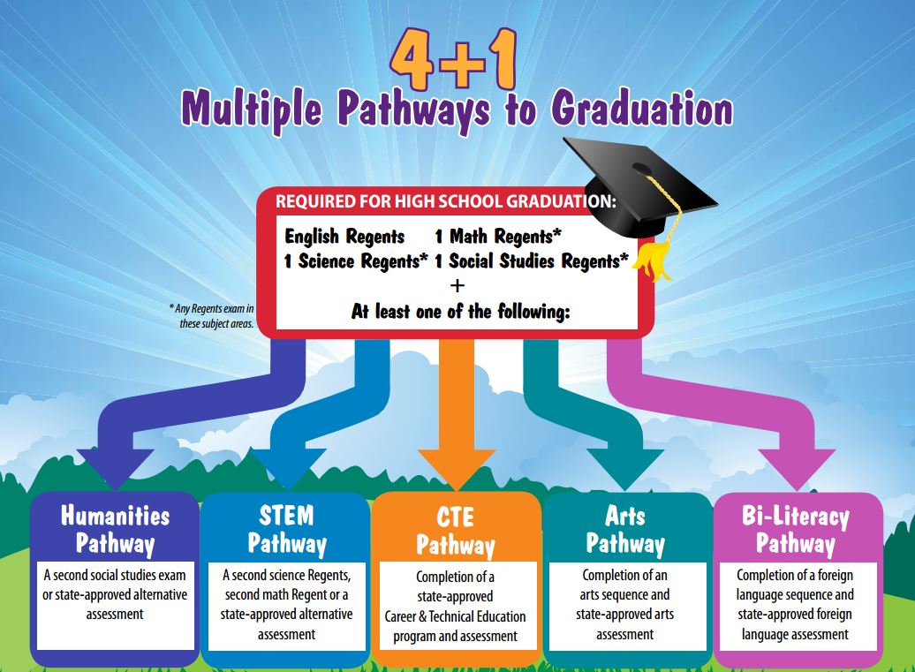

Slide 8

Standardized Testing
PSATs
SATs
SAT Subject Tests
ACTs
How to register: How to prepare:
CollegeBoard Kaplan
Princeton Review
ACT Website Khan Academy
**Links can also be found on the high school website
Departments > Counseling > High School Counseling Center tab

Slide 9

Naviance
Useful tool for college and career exploration!
Family Connection

Slide 10

SchoolTool
An easy way to keep track of grades, assignments, attendance, scheduling, etc.
Course Selections
Available on the school website!

